Slide 1
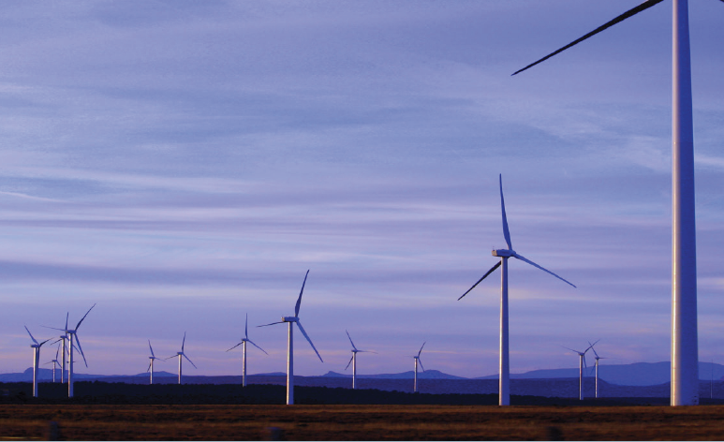
Myth busting renewable energy. ​
Professor Kylie Catchpole and Professor Ken Baldwin,
ANU Grand Challenge: Zero-Carbon Energy for the Asia-Pacific

Slide 2
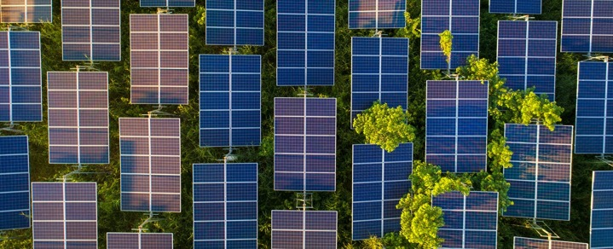
International Energy Agency report, May 2021
“The world has a viable pathway to building a global energy sector with net-zero emissions in 2050, but it is narrow and requires an unprecedented transformation of how energy is produced, transported and used globally”
From today, no investment in new fossil fuel supply projects
By 2035, no sales of new internal combustion engine passenger cars
By 2040, the global electricity sector has already reached net-zero emissions.

Slide 3
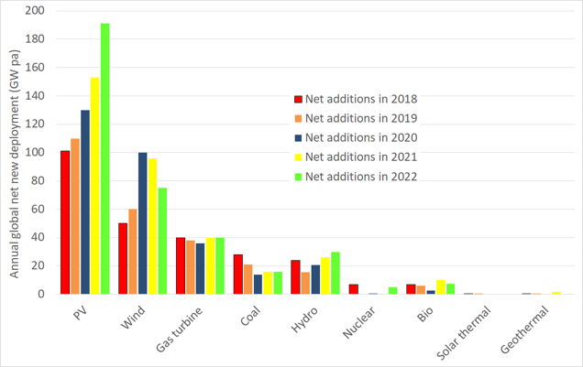
Global annual net new capacity per annum
There is a revolution happening in the type of energy that is being installed

Slide 4
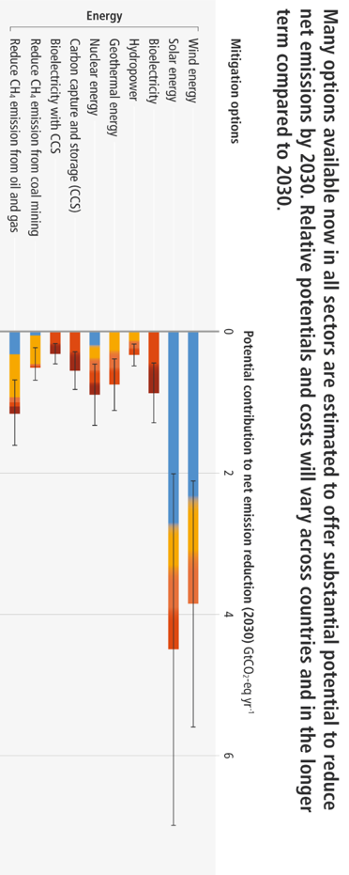
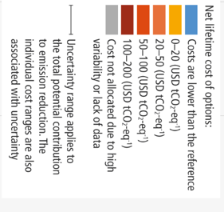
Solar and wind are the largest contributors across all sectors, not only energy

Slide 5
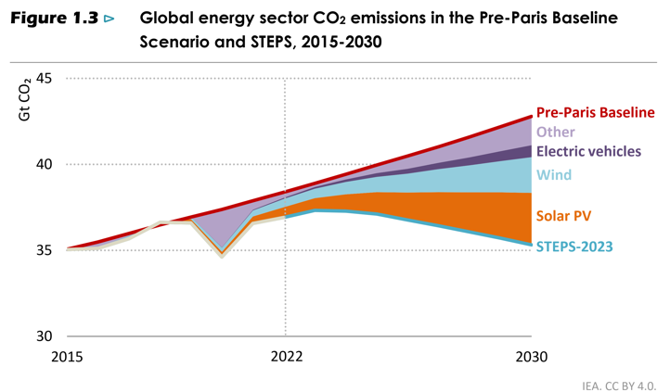
IEA Net-zero roadmap 2023
Solar projected to reduce emissions by 3Gt CO2 by 2030, approximately equal to emissions from all the cars on the road today
Wind will reduce emissions by 2Gt, EVs by around 1Gt.
IEA, World Energy Outlook 2019

Slide 6
Myth 1: Renewables can’t meet demand and keep the grid stable 24/7
Myth 2: Renewables take up too much land
Myth 3: Renewables are too expensive
Myth 4: Renewables can’t replace our energy exports

Slide 7
Myth 1: Renewables can’t meet demand and keep the grid stable 24/7

Slide 8
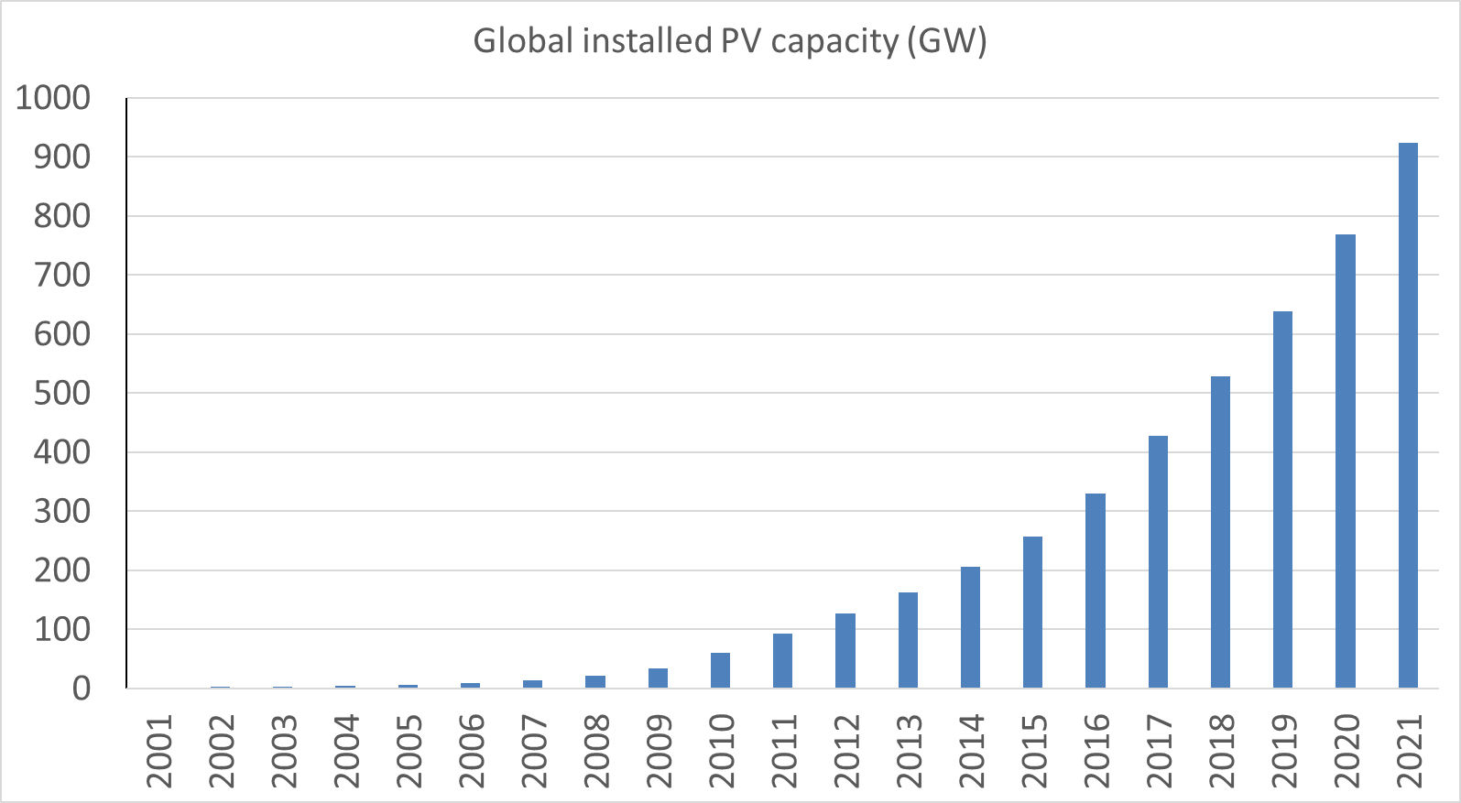
Continually growing solar deployment
1 terawatt
760 GW
>900 GW_{p} by 2021
Compared to 40 GW_{p} in 2010
Factor of 17 increase in 10 years (average yearly growth rate of 33%)
1 GW

Slide 9
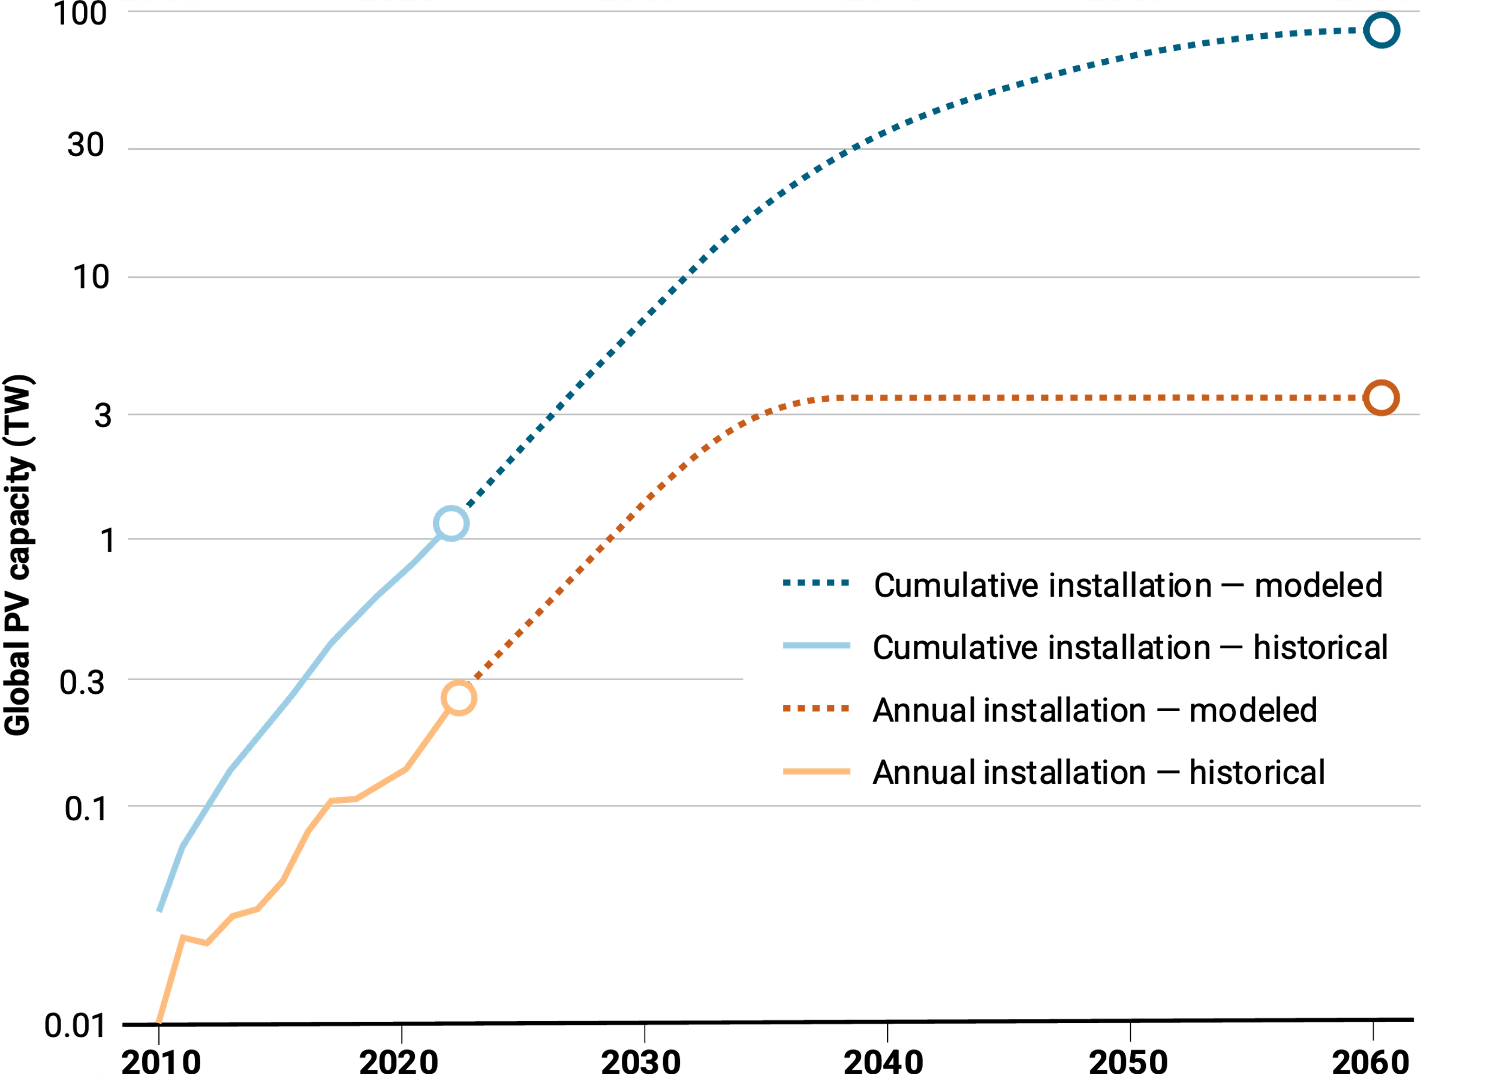
Global required new capacity
50-70% of global electricity demand by 2050 requires 25% growth rate to continue, and then decrease to replacement rate.
Requires annual installations globally to increase from 0.3TW to 3TW.
Haegel et al., Science 2023
DOI: 10.1126/science.adf6957

Slide 10
Reliability
Sector coupling: power, transportation, heating
Geographical dispersion
Technical diversity
  Wind, photovoltaics
Mass storage
  Pumped hydro
  Electric car batteries
  Hydrogen
  Batteries

Slide 11
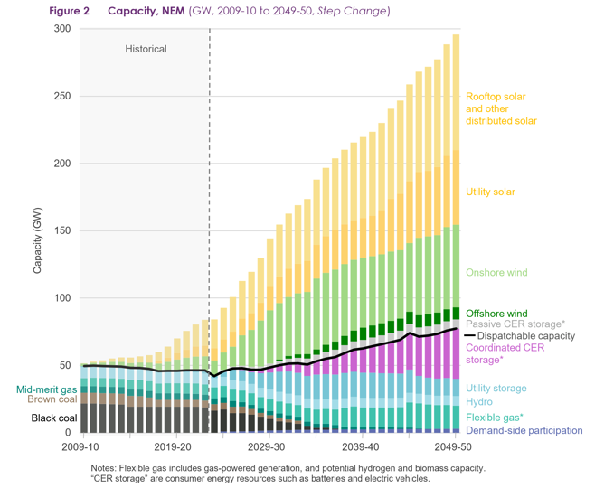
How much will we need?
AEMO draft 2024 integrated system plan

Slide 12
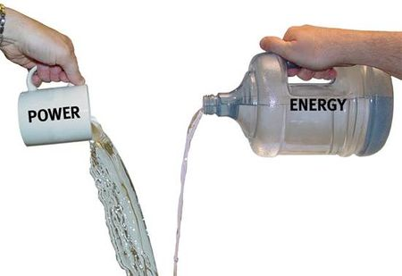
What about storage? Power vs energy
POWER
energy

Slide 13
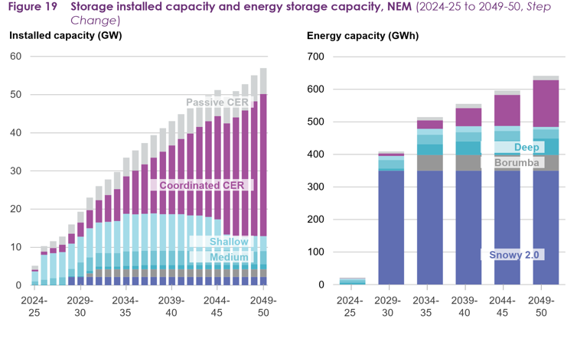
How much storage will we need?
AEMO draft 2024 integrated system plan

Slide 14
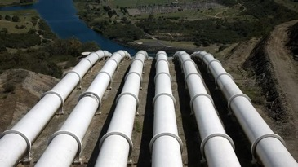
Energy balancing – over days
Long duration energy storage (LDES) > 8 hrs
Snowy hydro 5.5 GW
Snowy 2.0 increase to 7.5 GW
Snowy 2.0 = 350GWh or
175 hrs of operation
power (GW) x time (h) = energy (GWh)

Slide 15
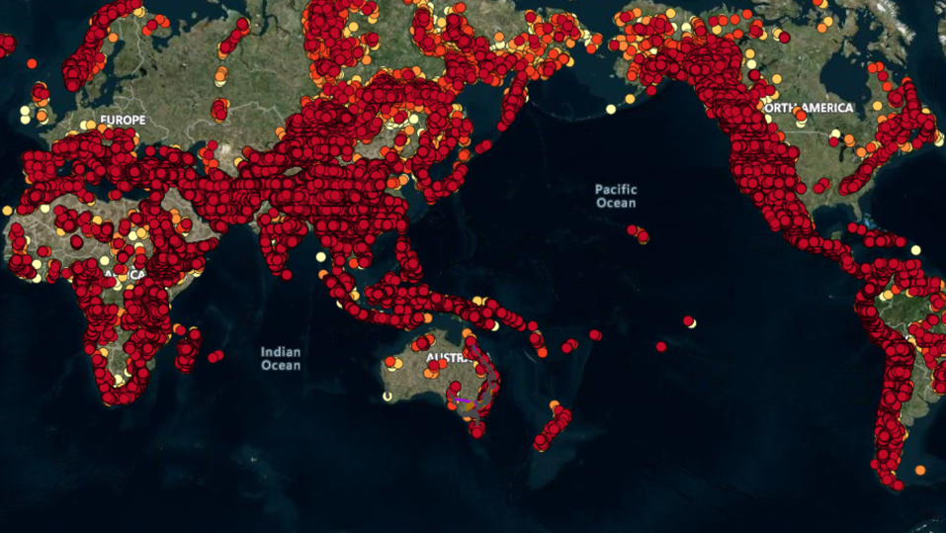
Global pumped hydro atlas
https://re100.eng.anu.edu.au/

Slide 16
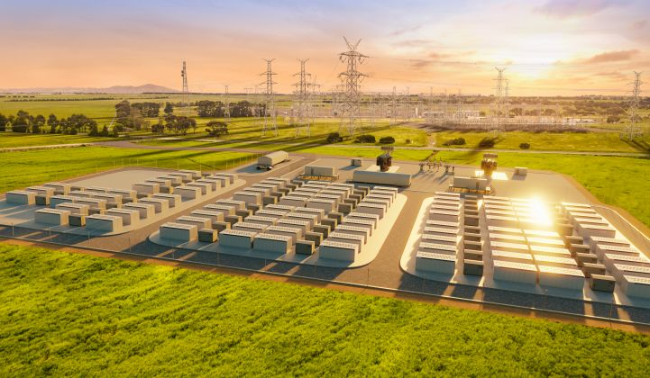
Battery storage
Batteries can respond very fast to disturbances.
Good for
short-term storage (hours)
helping with transmission constraints
Maintaining grid stability

Slide 17
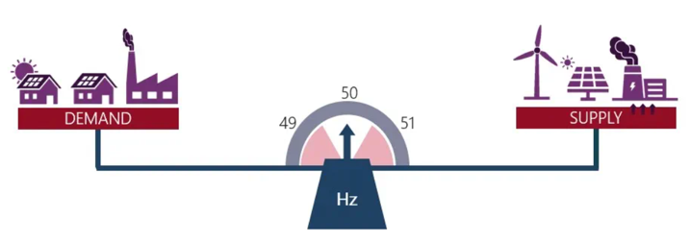
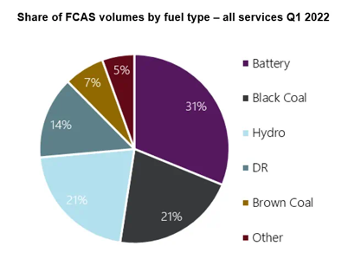
Batteries can respond very fast – so now largest frequency control and ancillary services (FCAS) provider in the NEM.

Slide 18
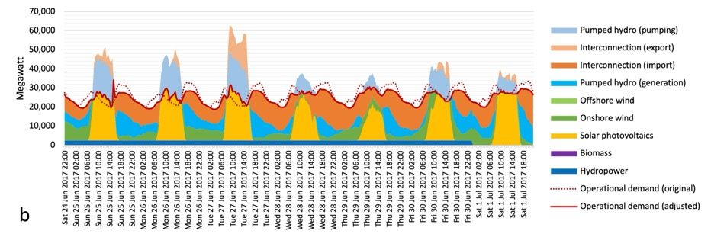
Modelled generation of 100% renewable electricity in Australia
Seasonal variability can be managed with pumped hydro, more renewables and transmission – but we need to get moving
Modelling from Bin Lu, ANU

Slide 19
Myth 2: Renewables take up too much land

Slide 20
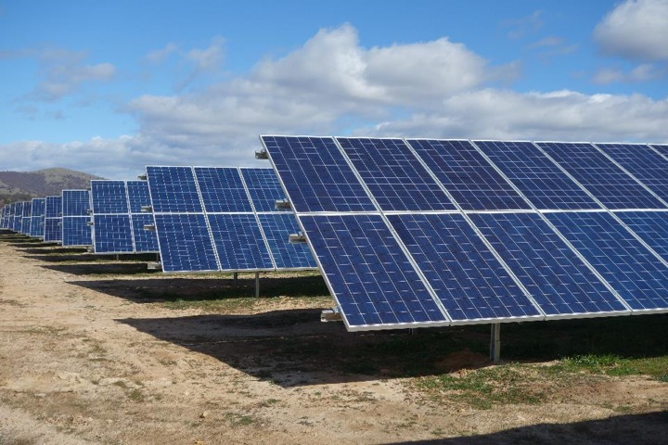
100% renewable energy (zero fossil fuels) means 60 m² of solar panel per person
Fraction of the world’s land: 0.1%
(at developed country energy consumption rates)

Slide 21
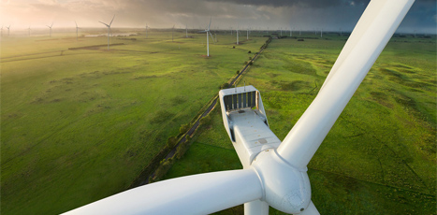
Macarthur wind farm, Victoria, 420 MW
112m rotor diameter, 3MW

Slide 22
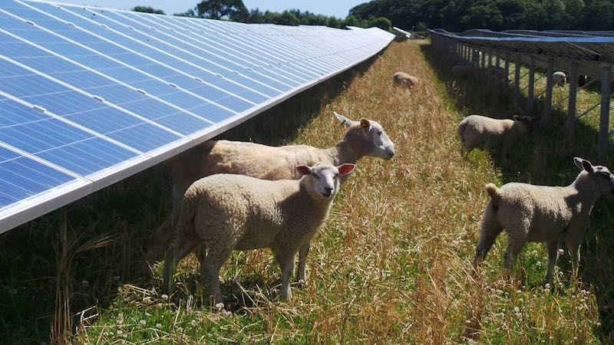

Slide 23
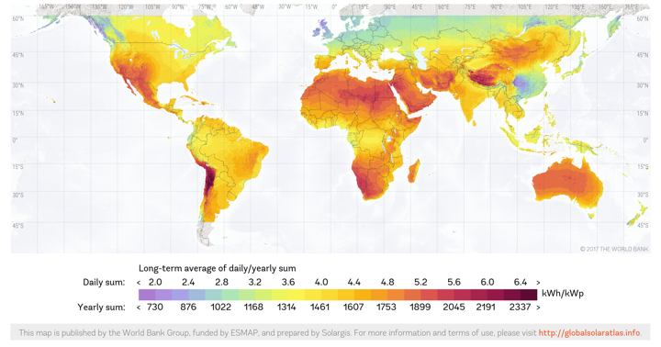
Australia’s opportunity for leadership
¾ of people live in the sunshine belt (+/- 35°)
High & consistent solar, no cold winters
Most of the growth in population, energy consumption and emissions
Solar availability – redder is better

Slide 24
Myth 3: Renewables are too expensive

Slide 25
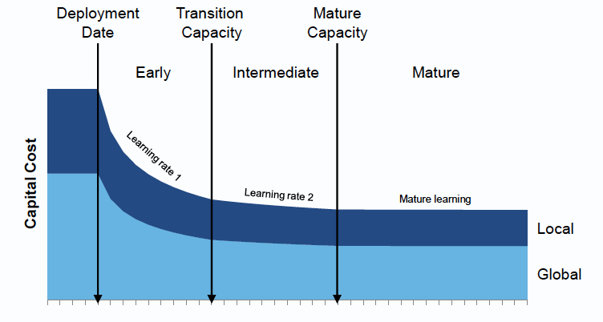
Learning rates
Source: CSIRO
Competing Technology
Number of units produced

Slide 26
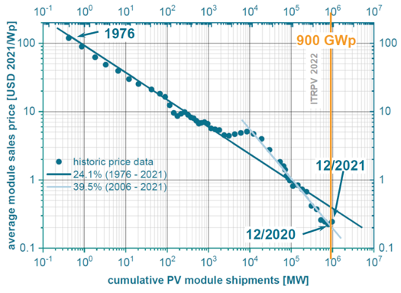
Technology learning rates: solar PV
Doubling the units of production decreases the price by 24.1%
This represents a compound annual growth rate (CAGR) of 33% for the last 40+ years!
1/500th
price per
module!
Source: 13th International Technology Roadmap for PV (2022)
Time

Slide 27
Learning rates for various technologies

Slide 28

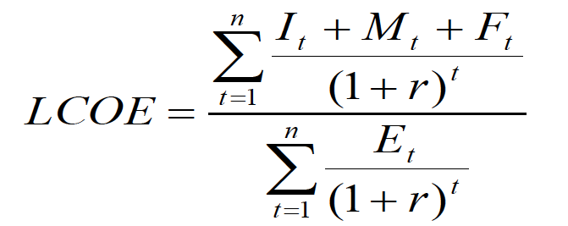
Levelised cost of electricity (LCOE)
Learning rate
LCOE
Caution: assumes
plug-and-play !
I_{t} = Investment in year t E_{t} = Electricity generation
M_{t} = Operations and maintenance r = Discount rate
F_{t} = Fuel expenditure n = Life of system (amortisation)

Slide 29
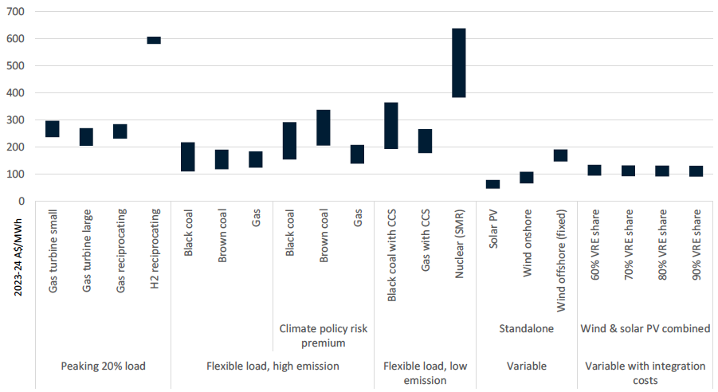
Australia: solar and wind now cheaper than coal
Fossil fuels
Fossil
fuels
+ CCS
Wind
& PV
Wind & PV
+ storage
+ transmit
ACT 2020
wind auction
$45/MWh
fixed price
($35-37 in constant $)
Present
LCOE
GenCost 2023/4
CSIRO & AEMO

Slide 30
How high can renewables go?
LCOE is only plug and play.
The higher the penetration of variable renewables (>50 %), the higher the cost to cover intermittency:
  Overbuild supply
  Build additional storage capability
  Build additional network infrastructure
At 100% RE, adds 50%
to LCOE -
but still cheaper than coal or gas
}

Slide 31
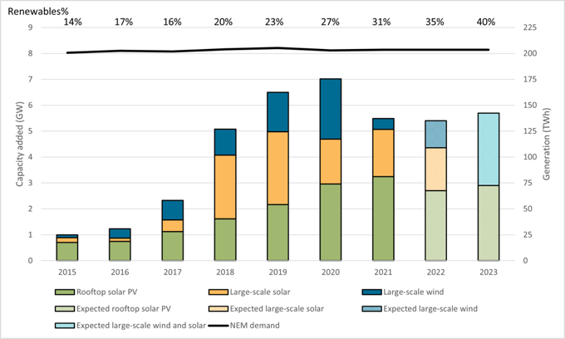
Australian Renewable Energy Pipeline
Source:
Clean Energy Regulator
99% of new generation in Australia is renewable. Australia has installed ~6GW p.a. solar and wind for last 5 years, >3GW p.a. at utility scale - despite past government policy uncertainty
Low large-scale investment <2017 because of govt. policy uncertainty

Slide 32
Myth 4: Renewables can’t replace our energy exports

Slide 33
Australia’s current energy trade
+ 4,933 tonnes Uranium = ~ 2,000 PJ
Most of Australia’s energy trade is with the Asia-Pacific
Source: DCCEEW Australian Energy statistics, Table J, 2023.
33

Slide 34
Australia’s top commodity exports 2021
Source:
DFAT trade and investment at a glance, 2021
Higher education
34

Slide 35
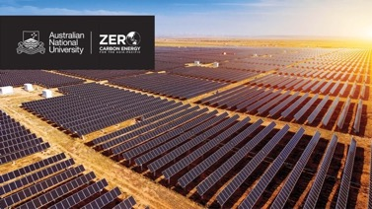
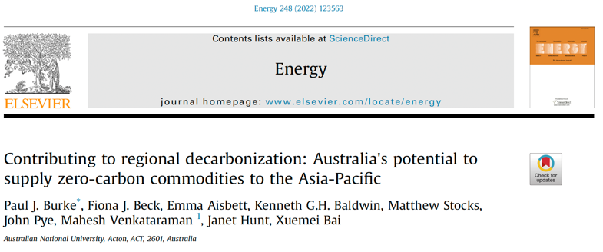
ANU Grand Challenge:
Zero-Carbon Energy
for the Asia-Pacific
$10m ANU-funded + industry + govt.
5-year program 2019 - 2023
Research projects:
  Hydrogen fuels
  Renewable electricity systems
  Green metals
  Policy & governance in the Asia-Pacific
  Indigenous engagement

Slide 36
Australia’s current export emissions profile
Total emissions = 1,969 MtCO₂e/y
~ 3.7 x Australia’s domestic emissions
Consequential emissions
from benchmark exports
Notes:
MtCO₂e/y = megatonnes of carbon dioxide equivalent per year

Slide 37
Australia’s solar resource
Double that of northern latitudes
World Bank Group global solar atlas 2020 https://globalsolaratlas.info

Slide 38
A future Australian export scenario
Same energy
20% 80%
Same ores
Export the same amount of energy (PJ) as now:
80% as hydrogen (65 Mt/year)
20% renewable electricity (540 TWH/y)
Mine the same amount of ore and export:
510 Mt/y as green steel (6 Mt/y steel now)
18 Mt/y as green aluminium (2 Mt/y Al now)
Total renewable electricity required
7,040 TWh/y
27 x Australia’s present electricity generation!
Add 100% domestic RE + 200% in electrification
= 2,700 + 100 + 200 = 3,000% renewables!
Even if only 10% of exports are realized, this still doubles Australia’s zero-emissions electricity future i.e. 600%.
Key message: on and off-grid renewables for export may dominate – and influence price and supply in – the domestic electricity sector
Notes:
PJ = petajoules
Mt/y = megatonnes per year
TWh/y = terawatt hours per year

Slide 39
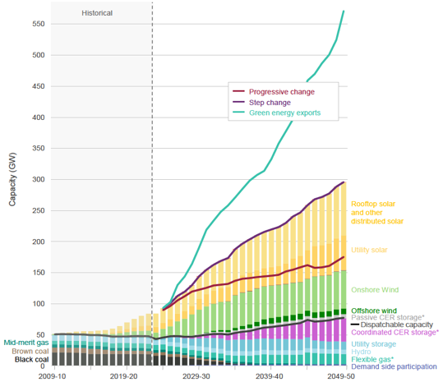
Future NEM
Green energy exports double NEM capacity
(ignoring off-grid hydrogen)
AEMO draft 2024 ISP key capacity scenarios:
Progressive (slow)
Step change (favoured by most stakeholders)
Green energy exports

Slide 40
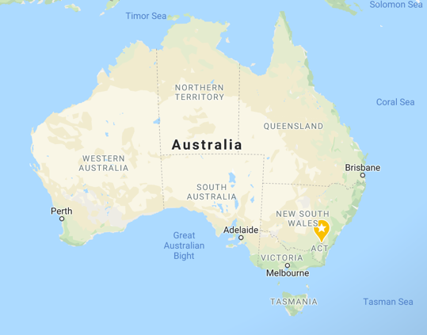
Proposed H₂ + e⁻ export projects >120GW new RE
Australian Renewable Energy Hub – 26GW
Yara Pilbara – 5GW
Province HyEnergy – 8 GW
Murchison Renewable H₂ – 5GW
Infinite Green Energy – 1GW
Western Green Energy Hub – 50GW
SA hydrogen export terminal – 0.25GW
Forrest Future Industries – 2GW
Stanwell – 3GW
Hydrogen Utility – 3GW
Sun Cable – 20GW (electricity)
e⁻
H₂,NH₃
H₂
NH₃
H₂
H₂
H₂
e⁻
H₂
H₂
NH₃
H₂

Slide 41
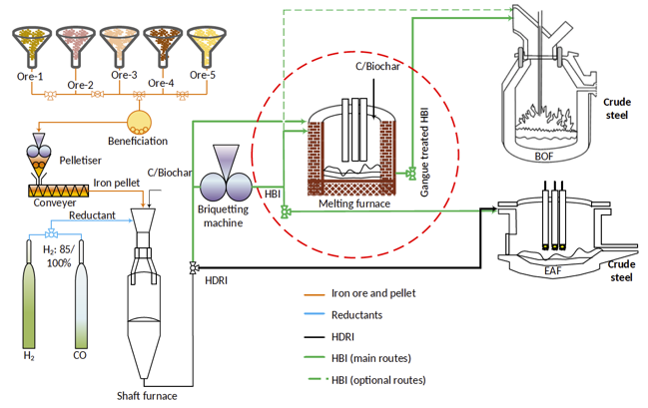
Green Steel
Australian exports
Renewables
Hydrogen

